Slide 1

EDA on Banking Loan Application
Jeetendra H. SARPE
05.05.2021

Slide 2

PROBLEM STATEMENT
THE BASIC GOAL of ANALYSIS
There are a number of loan defaulters and banks want to target the right people to provide loans to in order to raise their profits.
Analyze the banking data provided and come up with insights on the key factors in order to identify loan defaulters and how these factors are relevant in real life.

Slide 3

Insights on some Basic facts
Let’s Dive In

Slide 4
Gender Distribution
The number of female applicants is significantly more than male applicants.

Slide 5
Education Distribution
Most of the applicants education level is Secondary/Secondary Special

Slide 6
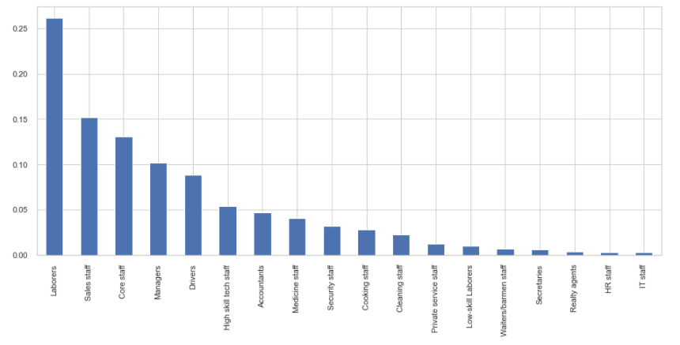
OCCUPATION Distribution
One out of four Applicant occupation is Labourer

Slide 7
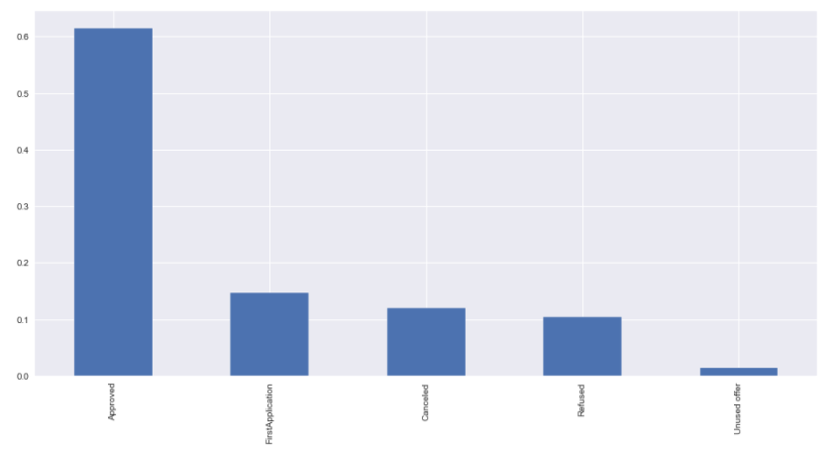
PREVIOUS APPLICATION STATUS
Most of the Applicants previous application status is Approved.
Very few of the Applicants don’t use the offer once approved.

Slide 8
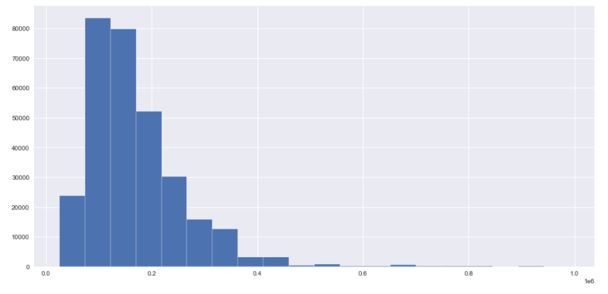
ANNUAL INCOME
Most of the Applicants are from low income group, income can be an important factor deciding the loan application approval.

Slide 9
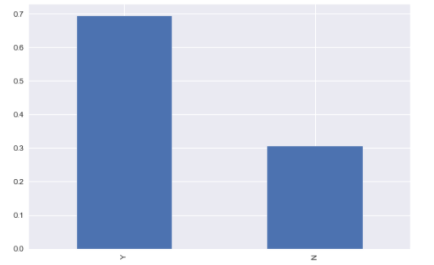
OWNS PROPERTY?
Most of the applicants own a property, this can be an important factor to make decide if the loan should be approved or not

Slide 10
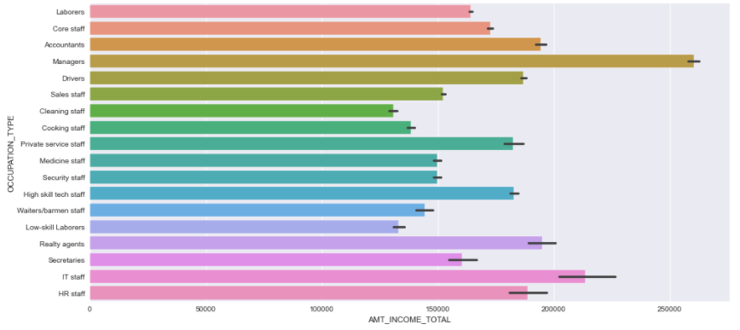
OCCUPATION vs INCOME
Most of the Managers have good income.
Cooking/Cleaning Staff and Low-skill Laborers are low income groups

Slide 11
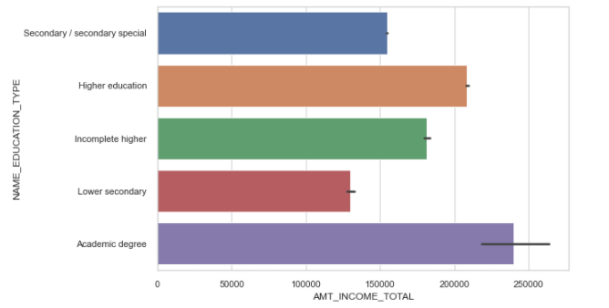
EDUCATION LEVEL vs INCOME
Applicants with Academic degree are earning well so their chances of repaying the loan is higher because of high annual income.

Slide 12
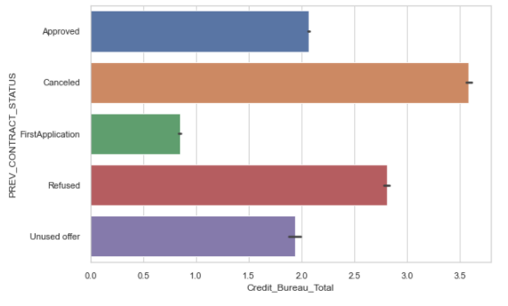
Credit Bureau vs Status of previous Loan Application
Applicants with higher Credit Bureau Total comes with higher risk
First time application has the lease chance of loan rejection

Slide 13
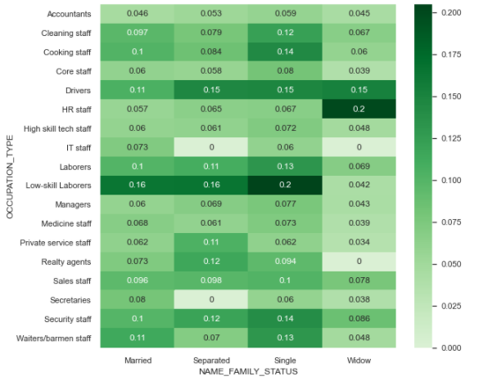
MARRITIAL STATUS VS OCCUPATION TYPE VS TARGET
Single low-skilled laborer's and widow HR-Staff and Drivers have highest chance of repayment.
Low-skill laborer's highly targeted in general.

Slide 14
TOP 10 CORRELATIONS in accordance to Target variable
Let’s Dive In

Slide 15
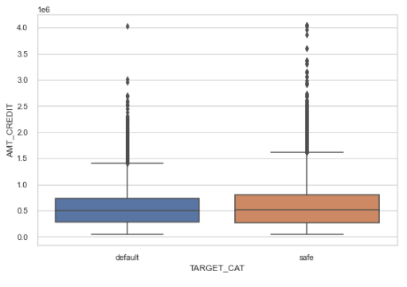
Amount of loan vs target

Slide 16
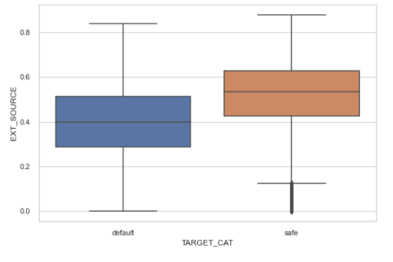
External Source vs Target

Slide 17
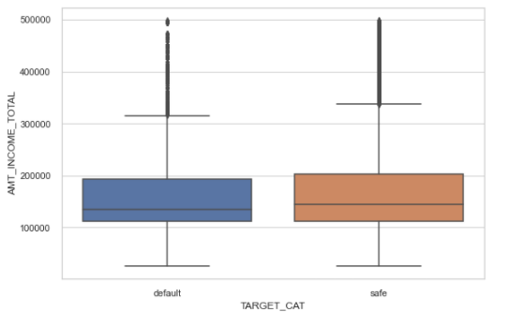
INCOME AMOUNT VS TARGET

Slide 18
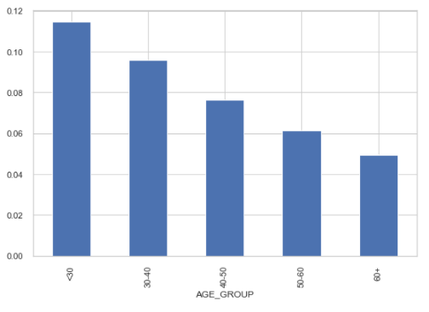
AGE GROUP vs TARGET MEAN

Slide 19
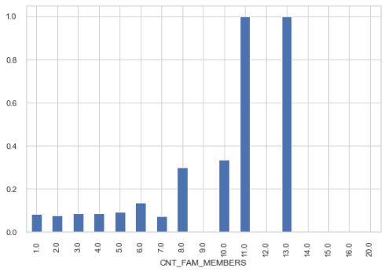
Family member count vs target

Slide 20
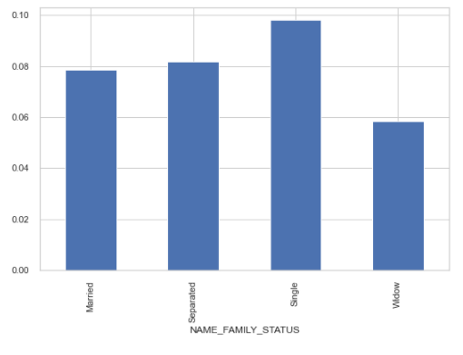
MERRITIAL STATUS vs TARGET

Slide 21
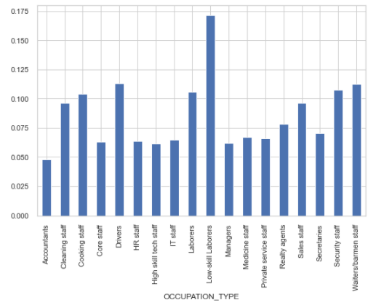
OCCUPATION TYPE VS TARGET

Slide 22
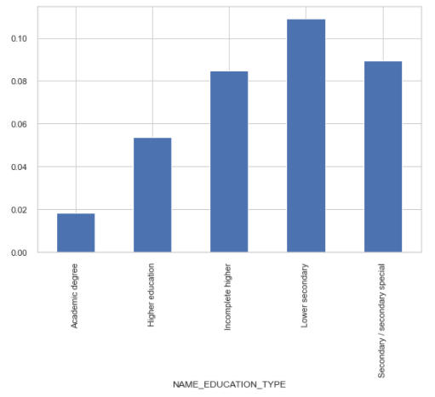
EDUCATION LEVEL VS TARGET

Slide 23
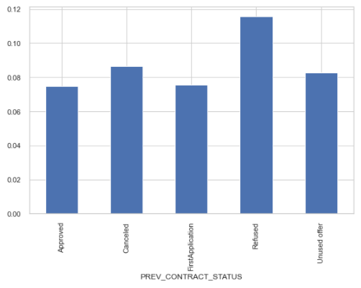
PREVIOUS CONTRACT STATUS VS TARGET

Slide 24
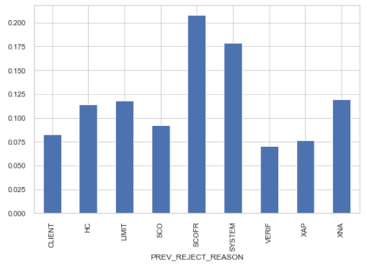
PREVIOUS REJECTED REASON VS TARGET

Slide 25
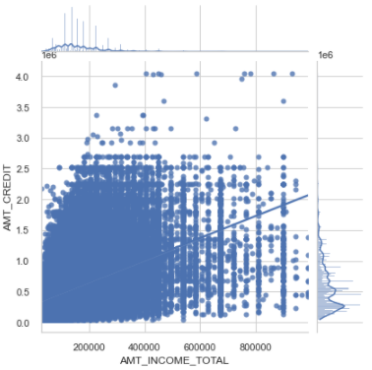
Amount income vs amount Credit

Slide 26
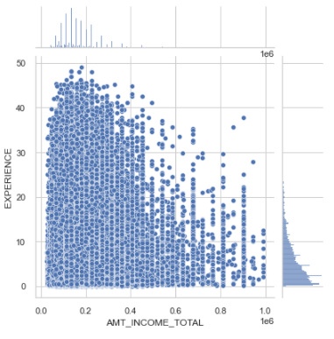
TOTAL INCOME VS EXPERIENCE

Slide 27
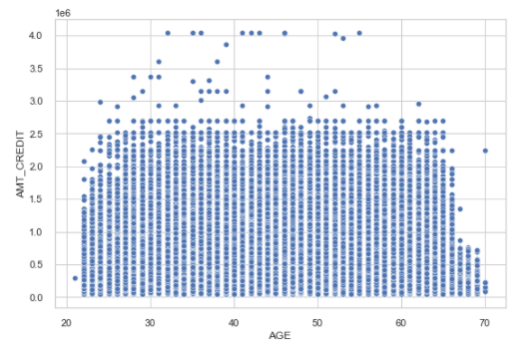
AMOUNT CREDIT VS AGE

Slide 28

Thank you!

